Slide 1
PARTITION LITERATURE IN INDIA
It is about,
Communal violence
Experiences of Women
Role of Literature

Slide 2
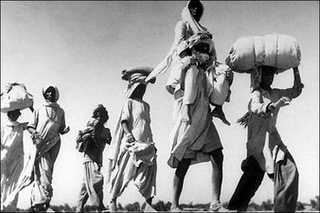
In 1947
India and Pakistan

Slide 3
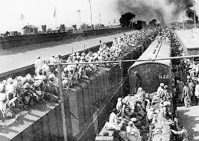
Traumatic Partition of India

Slide 4
Functions of Partition Literature
It helps to revisit the crucial event of partition in Indian History keeping in view of its repercussion
Its Cultural, literary and historical narratives contribute to nation formation
It helps to perceive the role of historical narratives in the Indian context and to note the changes in partition historiography
It is established as a bearing witness to the horrors of partition

Slide 5
Functions of Partition Literature
It helps to revisit the crucial event of partition in Indian History keeping in view of its repercussion
Its Cultural, literary and historical narratives contribute to nation formation
It helps to perceive the role of historical narratives in the Indian context and to note the changes in partition historiography
It is established as a bearing witness to the horrors of partition

Slide 6
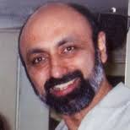
Radcliff’s LOC (Line of Control)
Suvir Kaul comments on LOC, “it is the complex partition, political and civic fault lines ....fault lines of religion, gender, caste and class which still run through our lives”
( the editor of Partition of Memory)

Slide 7
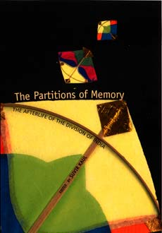
The Partitions of Memory
The Afterlife of the Division of India

Slide 8

Partition of Memory
(an anthology of eight stories)
Contributors
Mukulika Banerjee
Mukulika Banerjee is Reader in Anthropology at University College London.

Slide 9
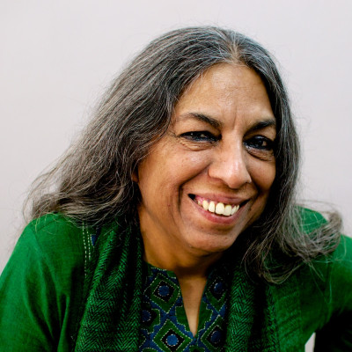
Urvashi Butalia
Urvashi Butalia is an Indian feminist and publisher. Along with Ritu Menon, she co-founded Kali for Women, India's first exclusively feminist publishing house, in 1984.

Slide 10

Joya Chatterji
Joya Chatterji FBA is Professor of South Asian History and a Fellow of Trinity College at the University of Cambridge. She specialises in modern south Asian history and is the editor of the journal Modern Asian Studies.

Slide 11
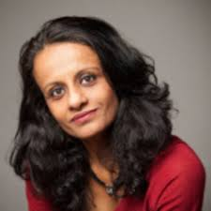
Priyamvada Gopal
Priyamvada Gopal is University Reader in Anglophone and Related Literatures in the Faculty of English at the University of Cambridge and Fellow, Churchill College

Slide 12
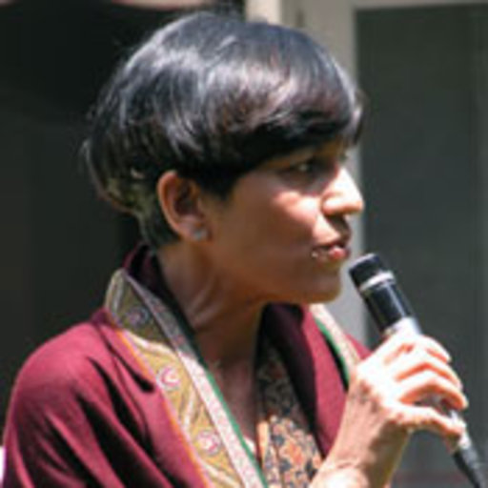
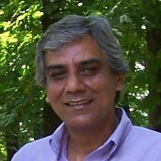
NitaKumar Sunil Kumar
Professor Professor
Claremont Mc Kenna Delhi University
College

Slide 13
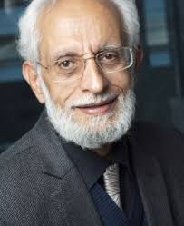
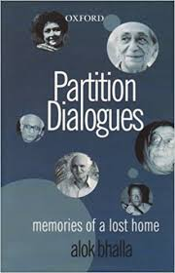
Alok Bhalla’s Partition Dialogues Memories of a Last Home

Slide 14
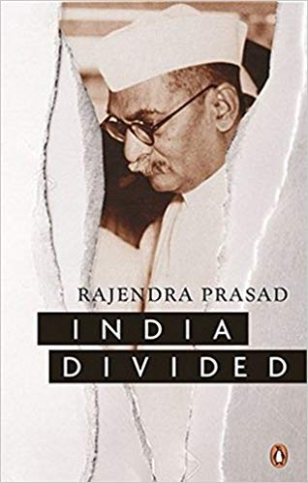
Rajendra Prasad’s India Divided
Written in the prison
Published in 1946
The solution for the Hindu Muslim issue should be sought in the formation of a secular state, with cultural autonomy for the different groups that make up the nation.
about Lahore Resolution

Slide 15
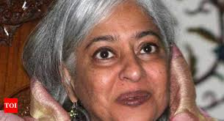
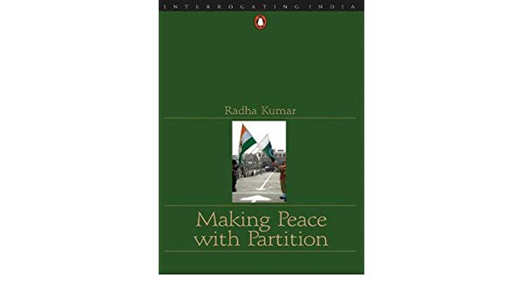
(A Feminist ) Radha Kumar’s Making Peace with Partition

Slide 16
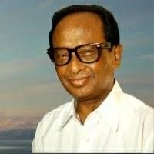
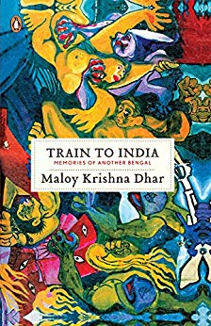
Malay Krishna Dhar (1937- 2012)
FROM THE AUTHOR OF OPEN SECRETS, THE UNTOLD STORY OF THE HUMAN TRAGEDY IN BENGAL BEFORE, DURING AND AFTER PARTITION.

Slide 17
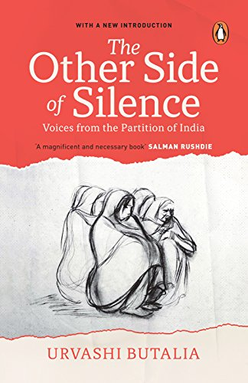
Urvashi Butalia
The Partition of India in 1947 - over twelve million people were displaced amidst a frenzy of murder, rape and abduction on a massive scale. For decades these violent realities remained buried in silence, even though the memories of brutality never faded.

Slide 18
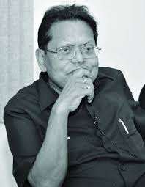
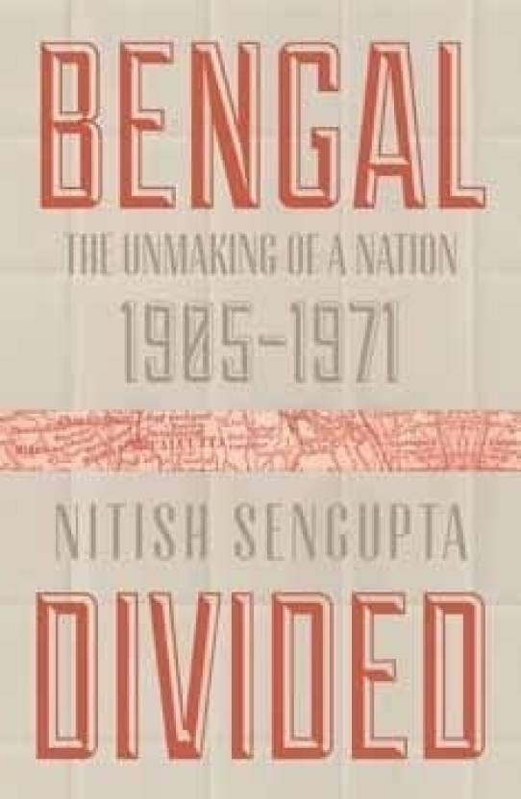
Nithish Sengupta (1933-2013)

Slide 19
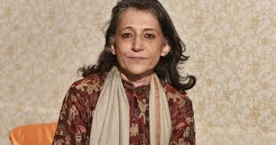
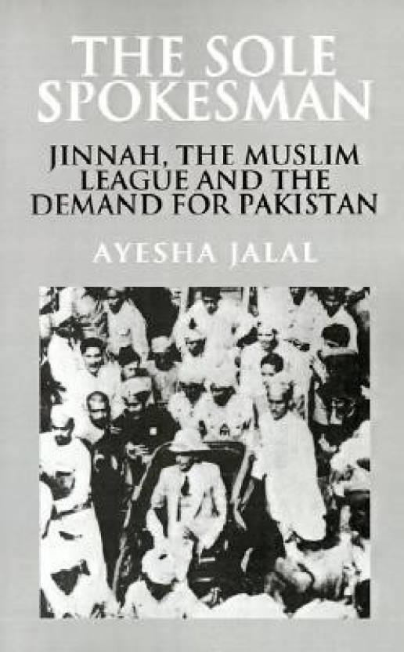
Ayesha Jalal, a historian

Slide 20
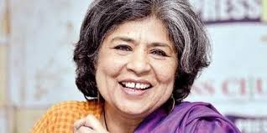
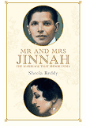
Sheela Reddy ‘s Mr &Mrs Jinnah, the marriage that shook India (2017)

Slide 21
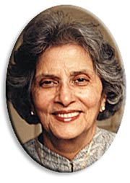
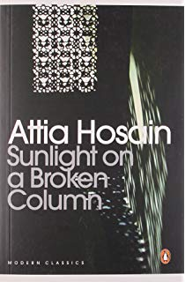
FICTION
Attia Hasain (1913-1998)
Sunlight on a Broken Column
Attia Hosain was born into a feudal family in Lucknow, north India in 1913 and grew up knowing many of the major political and literary figures of the time.

Slide 22
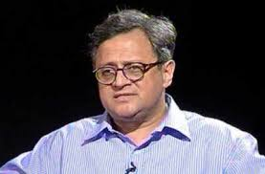
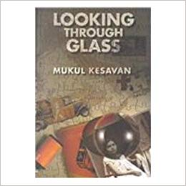
Mukul Kesavan’s Looking through Glass (1957)

Slide 23
Looking through Glass
A powerful and hugely entertaining novel
He journeyed through Muslim neighbourhood in 1942

Slide 24
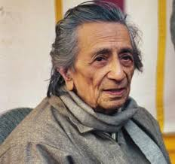
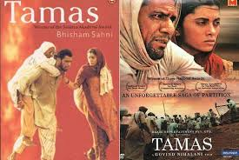
Bhisham Sahni’s (1915-2003)
Tamas

Slide 25
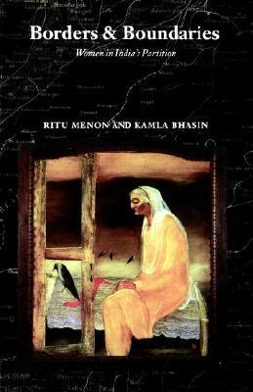
Ritu Menon & Kamla Bhasin
As an event of shattering consequence, the Partition of India remains significant today. While Partition sounds smooth on paper, the reality was horrific. More than eight million people migrated and one million died in the process. The forced migration, violence between Hindus and Muslims, and mass widowhood were unprecedented and well-documented.

Slide 26
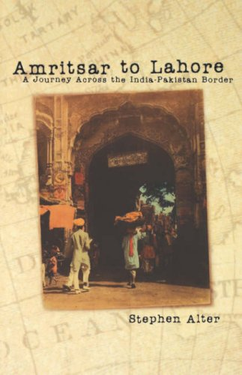
Stephen Alter
it is a personal travelogue of Stephen Alter, who took a journey to Pakistan by road in 1997, the 50th year of India’s partition as well as India’s independence from the British.
Pakistan and India are twins lying next to each other – they can not stay together but they can not move away as well. It is ironic that we were one country in the recent past.

Slide 27
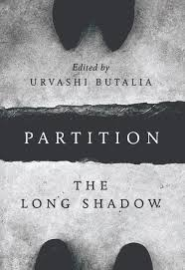
Urvashi Butalia

Slide 28
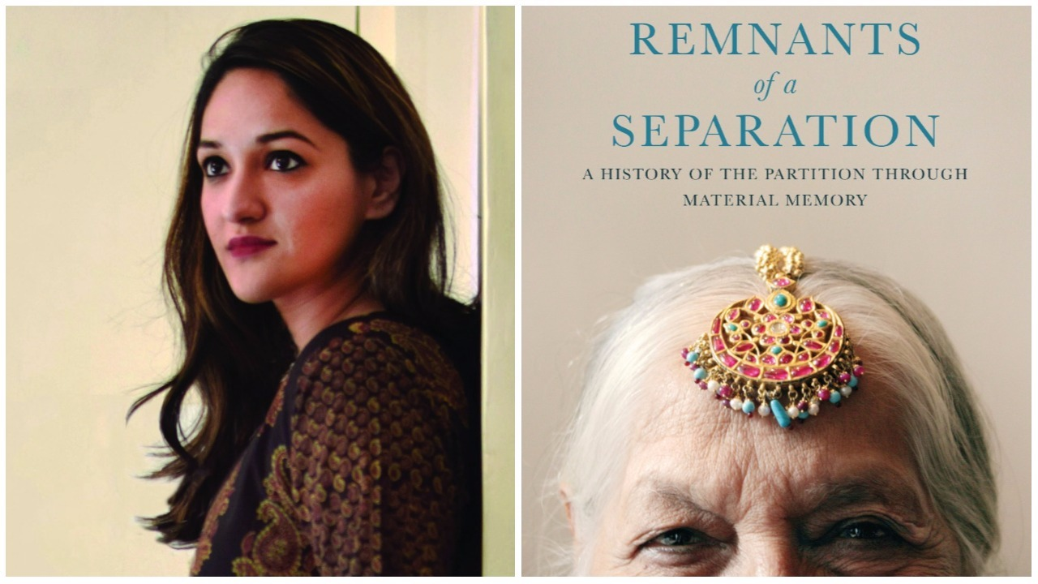
Aanchal Malhotra
Remnants of a Separation is a unique attempt to revisit the Partition through objects that refugees carried with them across the border.. They now speak of their owner's pasts as they emerge as testaments to the struggle, sacrifice, pain and belonging at an unparalleled moment in history

Slide 29
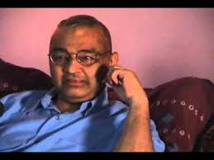
Agha Shahid Ali
“ your history gets in the way of my memory...your memory gets in the way of my memory...my memory keeps getting in the way of your history”

Slide 30

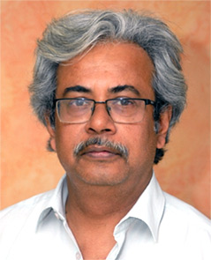
Ajaz Asraf a journalist whose 2014 novel The Hour Before Dawn revolves around the demolition of Babri Masjid “ As a journalist you can’t tell the truth , but as a novelist you can.

Slide 31
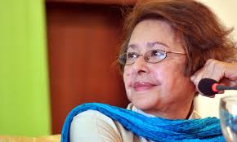
Bapsi Sidhwa
, “Novels are, I think more truthful than historical accounts. Historians only quote the politicians and catalogue prejudices of the period. It is the novelists who try to convey the emotional truths of individual people”

Slide 32
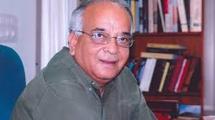
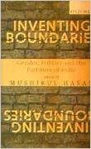
Mushirul Hasan, a historian affirms that partition literature has captured the tragedy of the event better than any historian’s account. He writes in his Inventing Boundaries; Gender, Politics and the Partition of India “ .

Slide 33
Bhisham Sahni’s (1915-2003)
Tamas

Slide 34
Witness Narratives
Recreating Partition horror through Novels
Responding to partition: Some women writers
Short Stories

Slide 35
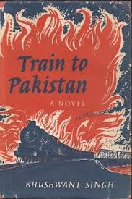
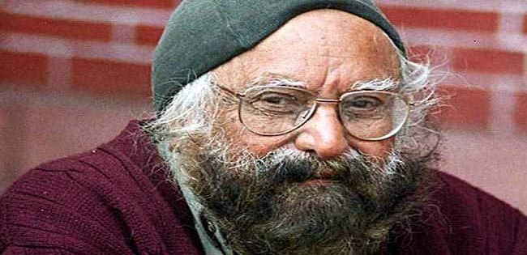
Khushwant Singh

Slide 36
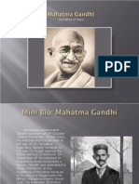
Raj Gill’s The Rape
Communal Holocaust

Slide 37
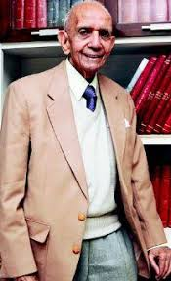
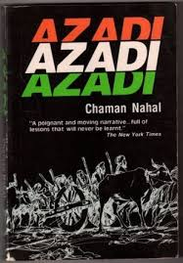
Chaman Nahal

Slide 38
Bhisham Sahni’s (1915-2003)
Tamas

Slide 39
FICTION
Attia Hasain (1913-1998)
Sunlight on a Broken Column
Attia Hosain was born into a feudal family in Lucknow, north India in 1913 and grew up knowing many of the major political and literary figures of the time.

Slide 40
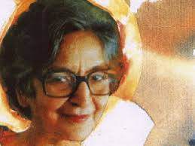
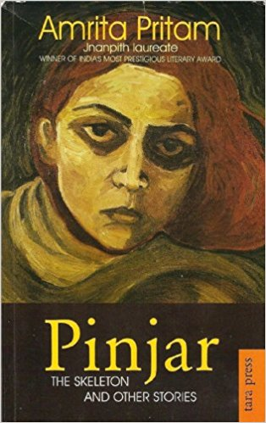
Amrita Pritam’s Pinjar translated by Khushwant Singh as The Skeleton

Slide 41
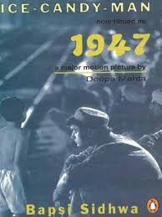
Bapsi Sidhwa, a Parsi’s Ice Candy Man

Slide 42
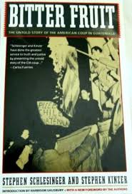
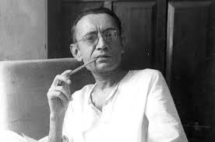
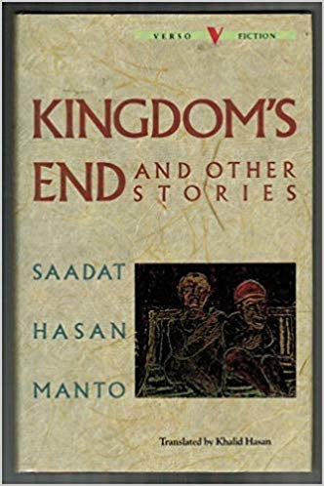
Saadat Hasan Manto

Slide 43
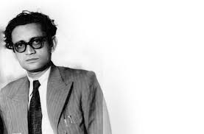
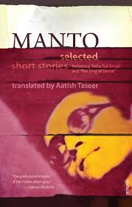
Aathish Taseer

Slide 44
All these works are about undesired collective past and recollect moral of partition

Slide 45


